Slide 1
Problem Statement Title:Blockchain-based:Loyalty and Rewards Program using Fungible Tokens
Team Name: CodeDemon

Slide 2

Team members details
Team Name | CodeDemon
Institute Name/Names | Indian Institute of Information Technology Guwahati (IIITG) Kalinga Institute of Industrial Technology (KIIT)
Team Members > | 1 (Leader) | 2 | 3
Name | Anand Sahu | Alok Sulya | Anirban Ball
Batch | 2020-24 | 2020-24 | 2020-24

Slide 3
Use-cases
Financial Services: Banks and fintech companies can offer rewards for specific financial behaviors, such as saving, investing, or using certain financial products.
Gaming Industry: Gaming platforms can integrate the loyalty program to reward players for in-game achievements, creating additional incentives for engagement and competition.
Hospitality Industry: Hotels and travel companies can offer rewards for booking accommodations, dining, and other services, encouraging repeat business and enhancing the guest experience.
Entertainment Platforms: Streaming services or ticket-selling platforms can use the program to reward users for consuming content or attending events.

Slide 4
Solution statement/ Proposed approach
The problem can be broken into:
Token Generation and Tokenomics:
Problem: Creating fungible tokens and defining their value and issuance rules.
Steps: - Develop smart contracts to create and manage fungible tokens based on a standard like ERC-20.
- Design tokenomics, including the initial token supply (the initial token supply is decided by platform)
- Decide on the value of each token, such as purchase of $50 will award one token.
- Also, we can have different token pools which can facilitate different motives (referral pool for referrals, social media pool, etc).

Slide 5
Solution statement/ Proposed approach
2. User Engagement and Token Earning:
Problem: This subproblem involves implementing mechanisms that allow users to earn tokens through various actions such as purchases, referrals, and social media interactions.
Steps:- Users have to register to the platform, and must have a wallet in order to interact with the loyalty program.
- Identify specific user actions that will result in earning tokens. For example, making a purchase, referring a friend, or sharing on social media.
- Users can earn tokens through various ways like purchasing, social media interactions, etc.
- Users can have access to their wallets, they can check the wallet status, token earned.
- Furthermore, users can play quizzes, games which Flipkart offers and can earn some extra tokens.
- Users can get few more tokens at festive season.

Slide 6
Solution statement/ Proposed approach
3. Settlement and Transparency:
Problem: This subproblem revolves around ensuring transparent and efficient settlement of tokens between various stakeholders, including brands, sellers, and the E-commerce platform. Steps: - Create smart contracts to facilitate seamless settlement between brands, sellers,and E-commerce platforms.
- Configure the smart contract to record settlement transactions on the blockchain.
- Each settlement transaction should include details of the parties involved, token amounts, and timestamps.
- Implement an on-chain mechanism for recording settlement transactions.
- Apply access controls to ensure only authorized parties can initiate settlements.
- Applied decaying feature on the backend in order to minimize the gas fee on the blockchain.

Slide 7
Solution statement/ Proposed approach
4. User Interface and Interaction:
Problem: This subproblem focuses on designing and developing a user-friendly interface that allows users to manage their loyalty points, view available rewards, and track their progress within the Loyalty and Rewards Program.
Steps:- Collaborate with UI/UX designers to create a visually appealing and intuitive interface.
- Connect the user interface with the blockchain data to display real-time information.
- Design a section where users can see their current token balance.
- Create a section to show users their transaction history, including earned tokens, redeemed rewards, and settlement records.
- Integrate the user interface with the smart contracts to trigger token transactions (earning, redeeming) and settlements.
- Provide user guides for customers, partners, and sellers on how to use the interface effectively.

Slide 8
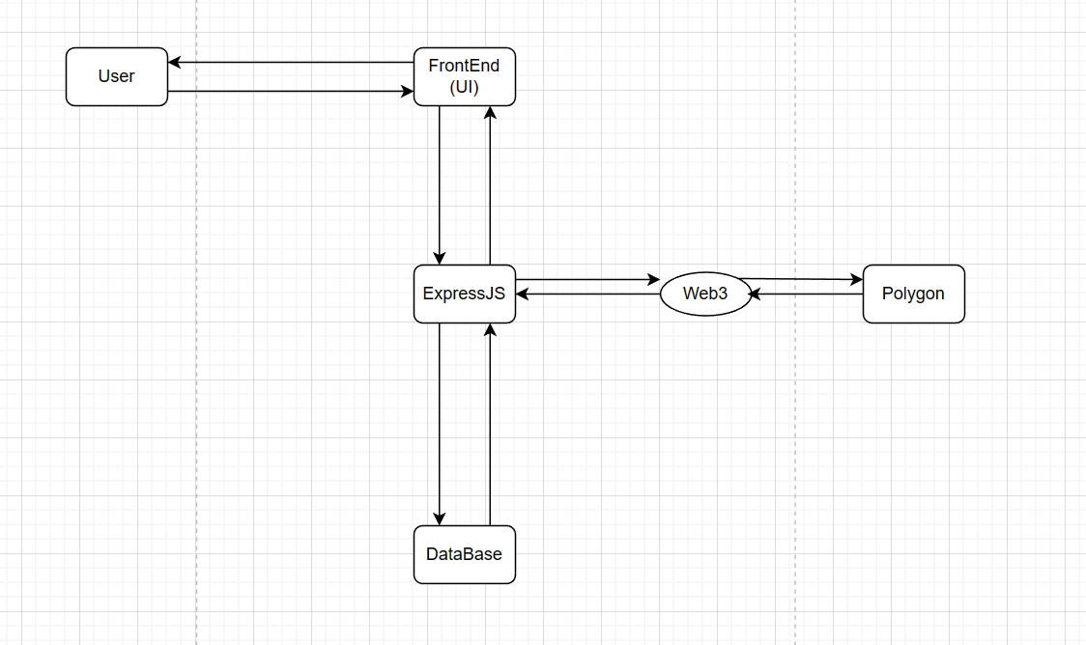

Slide 9
Limitations
Some possible limitations of the proposed solution include:
Cost Burden: High gas fees can accumulate substantial costs, making micro-transactions (such as awarding loyalty points for small actions) financially impractical for both the platform and users.
User Experience: Users may be discouraged from participating due to the extra costs associated with transactions. This could lead to reduced engagement and hinder the success of the loyalty program.
Blockchain Scalability: Introducing loyalty program on a blockchain could lead to scalability issues especially during peak usage, constraining transaction processing. Polygon is no different, it can handle up to 65,000 transactions per second, which is a great bottleneck.

Slide 10
Future Scope
s
Here are some possible future scopes and directions that the project could take:
Layer 2 Scaling Solutions: Implement Layer 2 scaling solutions like sidechains or state channels. These solutions allow for off-chain processing of transactions, reducing the load on the main blockchain and significantly lowering gas fees.
Dynamic Gas Price: Implement a system where users can choose to pay a higher gas fee if they want their transactions to be prioritized, while others can opt for lower fees but potentially longer confirmation times.
Hybrid Approach: Consider a hybrid model where critical actions that require high security are processed on the main blockchain, while less critical actions are offloaded to a Layer 2 solution.
Layer 2 implementation refers to secondary solutions built on top of a main blockchain (Layer 1) to enhance scalability and reduce transaction costs by processing certain transactions off-chain or in a more efficient manner.

Slide 11
Thank You

